Slide 1
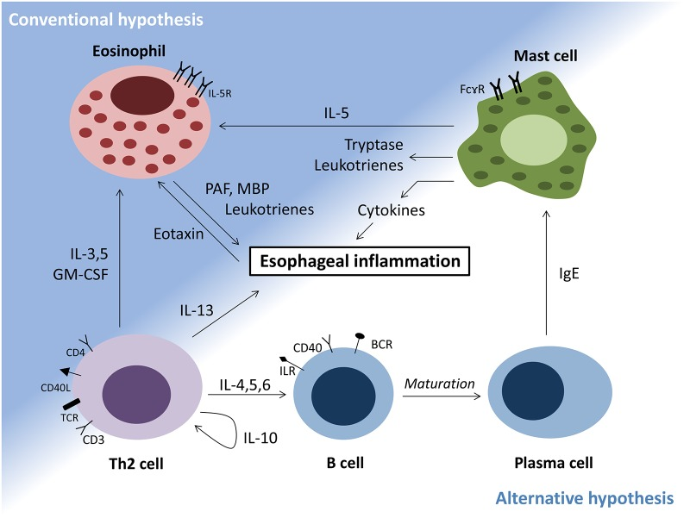

Slide 2
Антигенпрезентирующая дендритная клетка
Презентация антигена
Мастоцит
Th1 CD4+
Цитокины
Th0 CD4+
Лейкотриены
Гистамин
IL-4,5,13
Антигены
Th2 CD4+
В-лимф
Синтез IgE
Плазмоцит

Slide 3
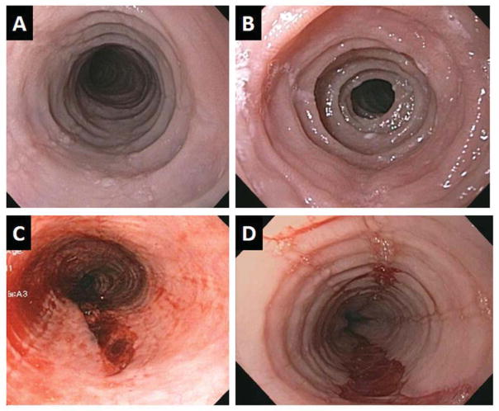
Notes:
Endoscopic imaging of 4 adult patients with eosinophilic esophagitis. Panels A and B illustrate remodeling changes of esophageal rings and stricture. Panels C and D illustrate esophageal mural tears that occurred following esophageal dilation likely indicative of diffuse loss of esophageal elasticity.

Slide 4
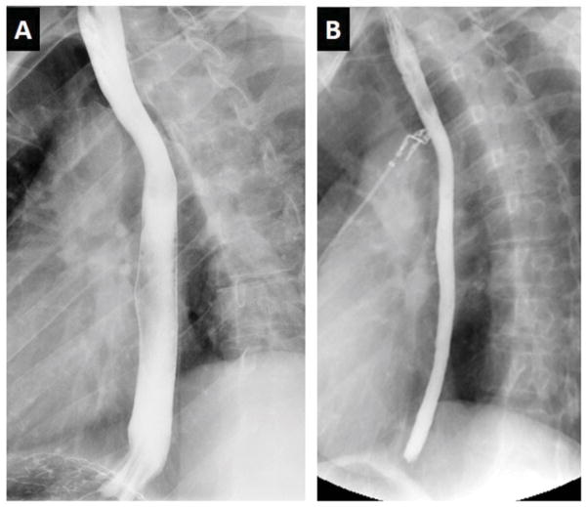
Notes:
Radiologic imaging in eosinophilic esophagitis. Barium esophagram in eosinophilic esophagitis. Panel A depicts a normal caliber esophagus in a patient with gastroesophageal reflux disease. Panel B shows an over 50% reduction in luminal diameter of the entire esophagus in an adult with eosinophilic esophagitis, a manifestation referred to as a narrow or small caliber esophagus.

Slide 5
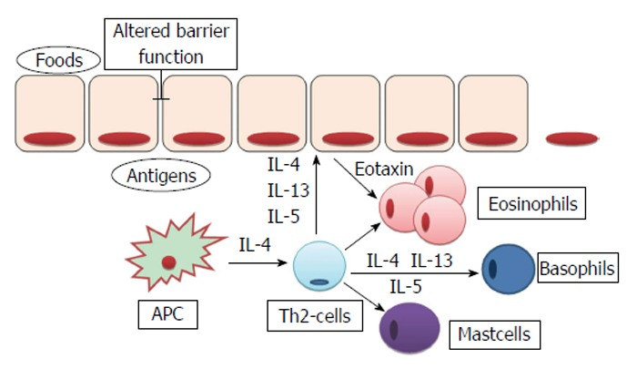
Расширенные межклеточные пространства
Пища
антигены
Эотаксин 3
Эозинофилы
Базофилы
Антигенпрезентирующая клетка
Тh2
Мастоциты

Slide 6
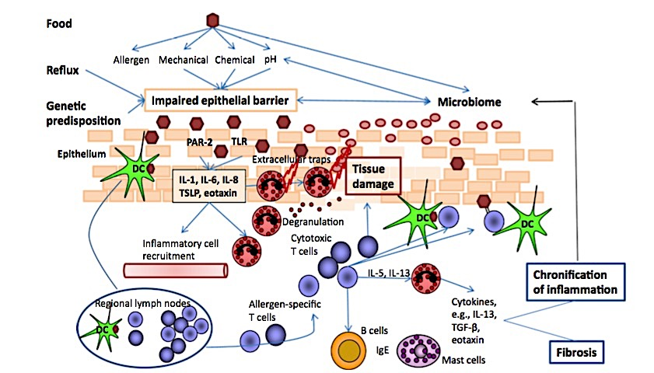
Current concepts in eosinophilic esophagitis
Dagmar Simon · Alex Straumann
Allergo J Int (2017) 26:258–266
Notes:
Pathomechanisms of eosinophilic esophagitis (EoE). Epithelial barrier impairment develops due to genetic predis- position and in consequence of re ux and food intake. Invad- ing allergens and microbial antigens cause activation of the in- nate and acquired immune system. Eosinophils degranulate, release toxic proteins, and generate extracellular DNA traps, which serve as a defense system but also cause tissue damage
By releasing cytokines, eosinophils modulate in ammation and promote its chroni cation, ultimately with brosis, all of which, in turn, have negative effects on skin barrier function. PAR- 2 protease-activated receptor 2, TLR toll-like receptor, DC den- dritic cell, IL interleukin, TSLP thymic stromal lymphopoietin, TGF-β transforming growth factor-beta, IgE immunoglobulin E

Slide 7
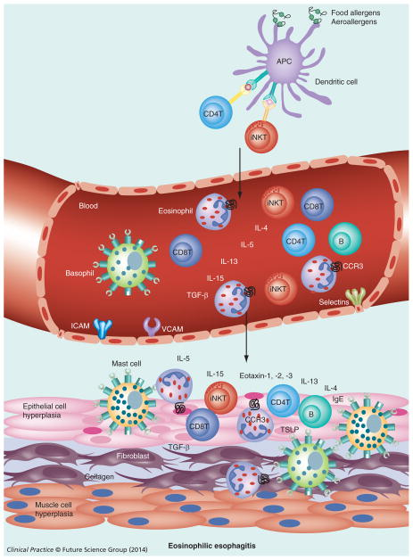
Diagnostic and therapeutic strategies for eosinophilic esophagitis
Asifa K Zaidi,1 Ahad Mussarat,1 and Anil Mishra*,1

Slide 8
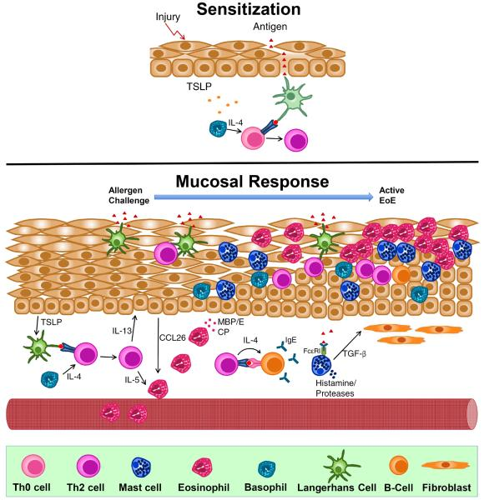
Allergic Mechanisms in Eosinophilic Esophagitis
Joshua B Wechsler1 and Paul J Bryce2
Notes:
Proposed allergic mechanisms involved in the pathogenesis of Eosinophilic Esophagitis (EoE). TOP: Proposed mechanism of allergic sensitization in EoE. In the presence of epithelial injury, TSLP production is elicited from epithelium. This primes basophils to produce IL-4 which promotes allergic sensitization after antigen presentation to a naïve T-cell which generates antigen-specific Th2 cells. BOTTOM: Proposed mucosal response in EoE. Subsequet antigen challenge leads to recruitment and expansion of Th2 cells which secrete IL-5 and IL-13, both critical in the recruitment of eosinophils and remodeling of the esophagus. Th2 cells locally promote class-switching of B-cells to produce antigen-specific IgE, which binds to the surface of mast cells. Activation of mast cells leads to the releast of pro-inflammatory mediators such as TGF-β, which promotes remodeling and enhances muscle cell contractility.

Slide 9
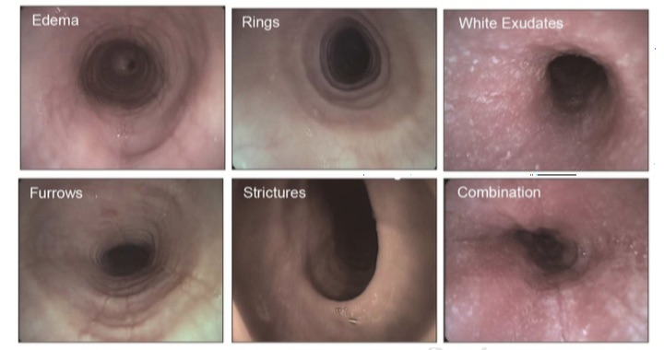
Отек
Кольца
Белый экссудат
Сужение
Стриктура
Комбинация

